Slide 1










Knowledge Discovery & Insights from User Generated Content ANALYTICS FOR UNSTRUCTURED DATA Session 2, 31st August, 2021
Dr. Anitesh Barua
David Bruton Jr. Centennial Chair Professor of Business
Distinguished Fellow, INFORMS Information Systems Society
University of Texas Distinguished Teaching Professor
McCombs School of Business, University of Texas at Austin
Email: aniteshb@gmail.com
Some slides are based on “Mine Your Own Business Article”

Slide 2
User generated content (UGC) can reveal new insights about brands, products & events
The idea
Find out what people are talking about
Find key entities (e.g., brands, products, etc.) & attributes (e.g., service, price, etc.)
Find associations between words
Visualize, correlate with business outcomes (e.g., switching)
© Anitesh Barua, 2021

Slide 3
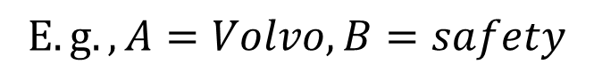
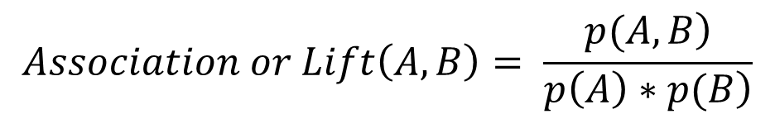
Co-occurrence of Terms
Do terms or words appear together in messages by chance or due to real association?
E.g., is Volvo more likely to mentioned in conjunction with safety related words than Toyota?
Is Honda more likely to be associated with reliability than, say, Jaguar?
$$Let A and B represent two words or phrases$$
$$E.g., A=Volvo, B=safety$$
$$Association or Lift\left(A,B\right)= \frac{\left.p(A,B\right)}{\left.p\left(A\right)∗p(B\right)}$$
$$where p\left(A,B\right) is the probability of both A \& B appearing in a message$$
$$where p\left(A\right) is the probability of A appearing in a message$$
$$where p\left(B\right) is the probability of B appearing in a message$$
Notes:
Only establishes presence of a “Connection” or “Co-occurence” between two topics (eg: Volvo and Safety ) Sentiment analysis is still necessary to extract the nature of this relationship/ co-occurance

Slide 4
Interpretation of Lift
Lift can be = 1, > 1 or < 1
What does it mean when Lift(A,B) = 1?
What about Lift (A,B) > 1?
What is the significance of the word Lift in this context?
What about Lift(A,B) < 1?
From a practical standpoint we don’t distinguish between Lift(A,B) = 1 or < 1
Notes:
Lift(A,B) > 1 implies A, B are strongly Co-occurant.
Lift(A,B) = 1 means A and B are INDEPENDENT and Not Associated.
Lift(A,B) < 1 means No Association. The two words are purposely NOT used together. (
eg: “My Hyundai drives like a McLaren” -> chances of Hyundai and McLaren occurring together is very very low [less than what we would expect from just random])

Slide 5
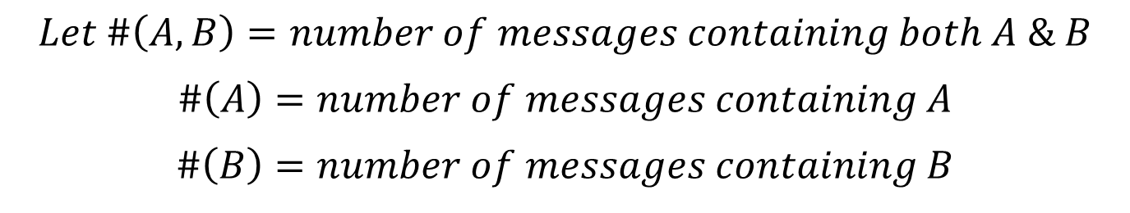
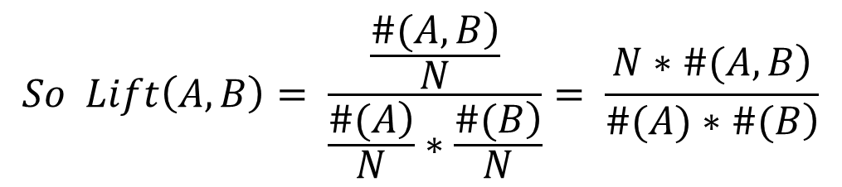
An Frequentist Interpretation of Lift
$$Let \#\left(A,B\right)=number of messages containing both A \& B$$
$$\#\left(A\right)=number of messages containing A$$
$$\#\left(B\right)=number of messages containing B$$
$$Then p\left(A,B\right)=\frac{\left.\#(A,B\right)}{N}, p\left(A\right)= \frac{\left.\#(A\right)}{N}, p\left(B\right)= \frac{\left.\#(B\right)}{N}$$
$$So Lift\left(A,B\right)= \frac{\frac{\left.\#(A,B\right)}{N}}{\frac{\left.\#(A\right)}{N}∗\frac{\left.\#(B\right)}{N}}= \frac{\left.N∗\#(A,B\right)}{\left.\#(A)∗\#(B\right)}$$
© Anitesh Barua, 2021
Notes:
Number of Samples needs to be large for LAW OF LARGE NUMBERS to kick in and the results would be incorrect if the sample size is small.
Lift = inf is just wrong because it means NO occurance of either A or B
The term word here refers to the “vocabulary” of the text.
If there is no occurance of chocolate in the text corpus, it means the word effectively does not exist.
So yes, you cannot sue lift in this case
N = Number of Messages in Corpus
#(A,B) = Number of times A,B co-occur
If we double N, Lyft should not change much because even #(A,B), #(A),#(B) will also increase(by a factor of approximately 2 too)

Slide 6











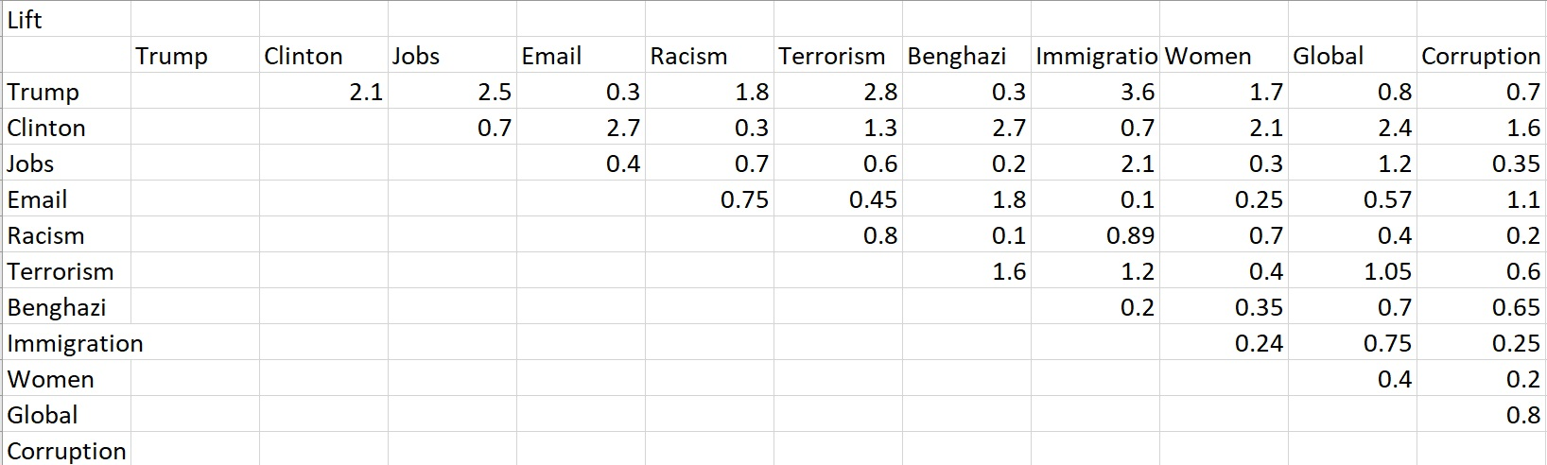
Which Associations are Strong?
?
© Anitesh Barua, 2021

Slide 7
An Example from Edmunds.com
 | Toyota Camry | Volvo S40
# mentions | 34,559 | 1160
# co-mentions with safety related words | 379 | 60
Lift of make/model & safety related words
Total # messages: 868,174 (assume one make/model
appears only once in a message
Safety related messages: 4534
What are the values of Lift(Volvo, safety) and Lift(Toyota, safety)?
Notes:
Lift(Volvo, Safety) = N * #(Safety,Volvo)/ #(Safety) * #(Volvo)
Lift(Volvo, Safety) = 868,174*60/(1160 * 4534) ~ 10.5
* A count of 60 is technically too less for Law of Large Numbers to kick in

Slide 8

What Does This Ad Say?
Do car enthusiasts and customers feel the same way?

Slide 9

Should we Emphasize Both Performance & Luxury?

Slide 10
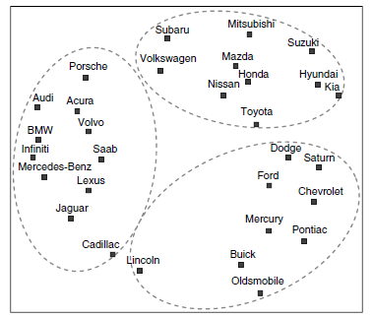
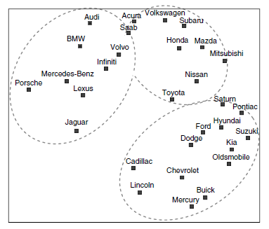
Can We Predict Switching Behavior?
Forum co-mentions
(100k mentions)
Actual brand switching
(3.5 million)

Slide 11
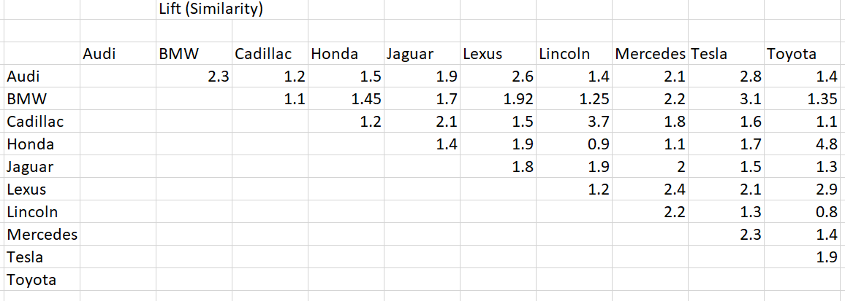
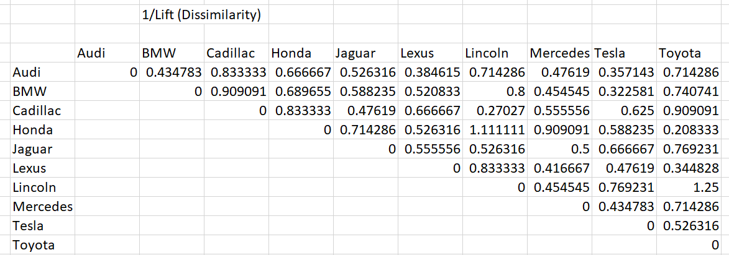
How to Draw an MDS Plot
Should we plot the lift values directly?
© Anitesh Barua, 2021

Slide 12
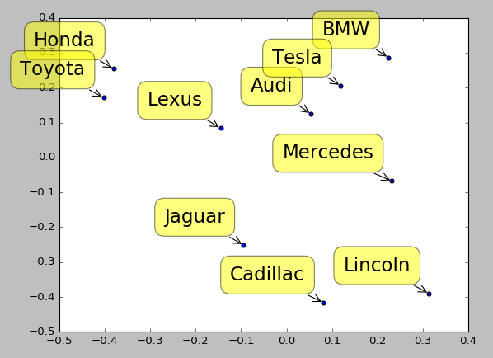
What do the MDS Axes Represent?
© Anitesh Barua, 2021

Slide 13
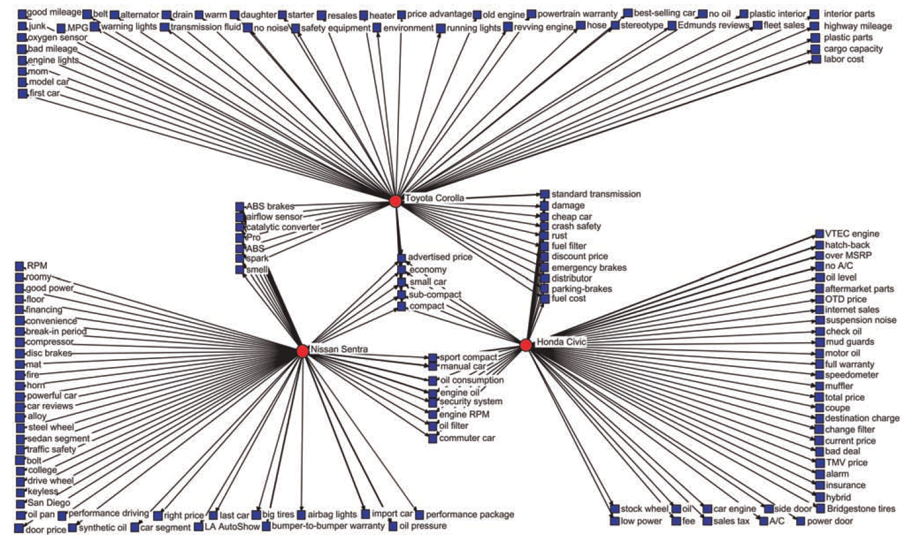
Product Attribute Associations

Slide 14
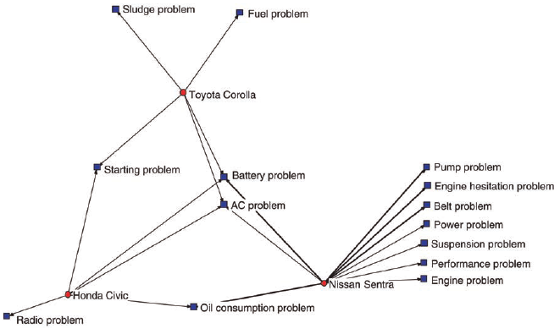
Negative Perceptions

Slide 15
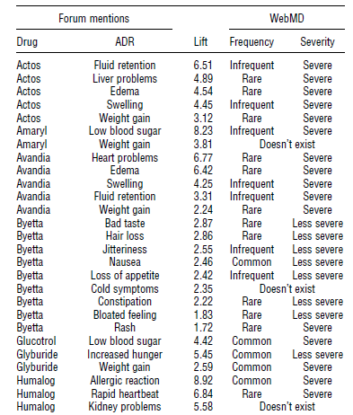
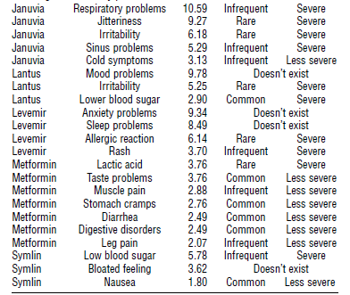
Crowds Vs. Experts

Slide 16
Beyond Pairwise Association
Do people compare Audi & BMW when they discuss performance?
Mentions
of Audi
Mentions
of BMW
#(A,B,P)
Mentions of
Performance
All Mentions
© Anitesh Barua, 2021

Slide 17
Conditional Lift
Lift(x,y|z) = P(x,y|z)/[P(x|z)*P(y|z)]
= [#(x,y,z)/#(z)] / [{#(x,z)/#(z)}*{#(y,z)/#(z)}]
= [#(x,y,z)*#(z)] / [#(x,z)*#(y,z)]
E.g., L(Audi, BMW|performance) =
[#(Audi, BMW, performance)*#(performance)] / [#(Audi,performance)*#(BMW,performance)]
Perf: 500; Audi & perf: 250; BMW & perf: 300; Audi, BMW & Perf: 200
L(A,B|P) = (200*500)/(250*300) = 1.33

Slide 18
How is Lift Different from Confidence?
Commonly found in commercial software packages
n% of people who mentioned word x (e.g., BMW) also mentioned y (e.g., Lexus)
Confidence(Lexus|BMW) = #(Lexus,BMW)/#(BMW) = (say) 125 / 300 = .417
Confidence is not symmetric
Also if most people talk about Lexus anyway, Confidence(Lexus|BMW) will not be a useful metric.
© Anitesh Barua, 2021
Notes:
Confidence(Lexus|BMW) = p(Lexus|BMW) = p(Lexus,BMW)
Lift( Lexus|BMW) = p(Lexus,BMW)/p(Lexus)*p(BMW) = Confidence(Lexus|BMW)/p(Lexus)
Thus, Confidence indicates if BMW is mentioned, what is the confidence Lexus will be mentioned too
But this could be misleading because maybe BMW is just mentioned a lot of times.
So, Lift is a better indicator of Co-occurance

